Slide 1
Machine Learning-Based
Salary Estimation & Career Intelligence
Presented by:-
PRATHAM SINGH(202410101150056)
KRISHNA VERMA(202410101150014)
B.Tech DS(51,52)
To : Raghav Sharma

Slide 2

Problems & Motivation
Why build a salary intelligence tool?
Salary benchmarks vary by role, seniority, company size, and location.
Scattered information:
Students and job seekers need a quicker way to explore historical salary patterns.
Salary estimates should include model-performance information and limitations.
Time-consuming comparison
Need for context :
PROJECT GOAL
Build an interactive dashboard that explores salary data and generates model-based estimates from job-profile information.

Slide 3
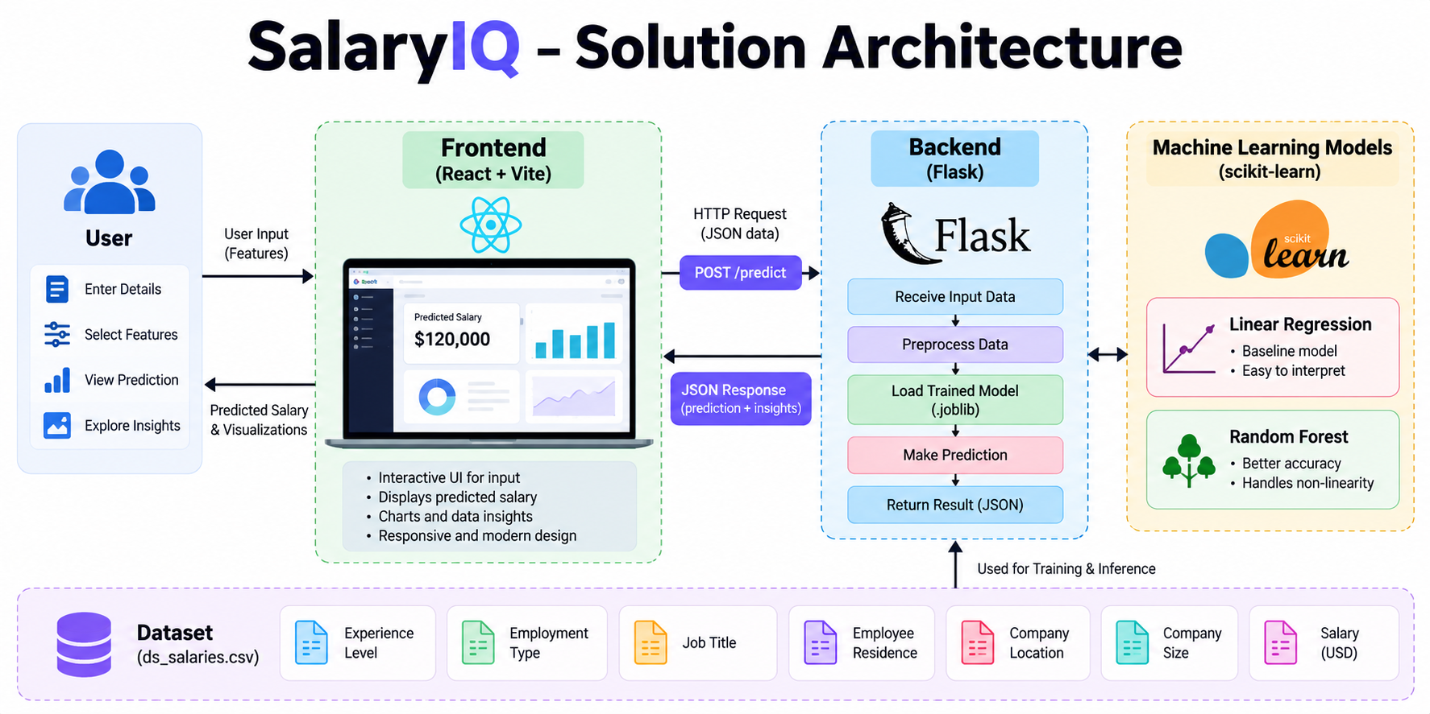

Slide 4

Application Features
Central Place to view Key information and Navigate the App.
React from send Profile details to Flask and displays the Response .
Evaluation metrices can be retrieved from the backend .
React and Vite provide a Web UI for Desktop and smaller screen.

Slide 5
Dataset & Input Features
Input :
Work Year and Experience level.
Employment Type and Job title.
Employee Residence and Company location.
Remote work Ratio and Company Size
Current Dataset :
Data Science Job Salaries (international dataset)
This dataset is international; the current model target is USD, not INR.
Important limitation
Next phase: source suitable Indian salary data, retrain and validate the model, then expose INR predictions.

Slide 6
Model Evaluation
LINEAR REGRESSION
MAE $40,002.25
RMSE $53,229.84
R² 0.3522
RANDOM FOREST
MAE $39,398.01
RMSE $52,829.22
R² 0.3619
Interpretation
  Random Forest is slightly better on these baseline metrics, but R² ≈ 0.36 indicates limited explanatory power. Predictions are estimates, not guarantees.

Slide 7
Frontend-Backend Integration
1. Collect Inputs :
2. Send Request :
3. Display Request :
React form collects job-profile fields and validates required values.
Axios sends JSON to Flask POST /predict.
The UI displays the estimate returned by the API.
LOCAL DEVELOPMENT
Frontend http://localhost:5173
Backend http://127.0.0.1:5000
CORS allows the browser-based React app to call the local Flask API.

Slide 8
Live Demonstration Plan
Start Flask
Start React
Open Dashboard
Run Prediction
Explain Result
Second terminal → cd salaryiq_frontend → npm run dev
Activate .venv → cd backend → python app.py
Visit http://localhost:5173
Enter profile details and submit the form
Show estimate, metrics, and model limitations

Slide 9
Limitations & Future Scope
Current limitations
International dataset and USD target
Baseline model accuracy is limited
Planned improvements
Obtain suitable Indian salary data
Retrain and validate for INR
Predictions depend on data coverage
No direct skills/education columns
Connect charts to real data
Improve validation and deployment
Success criteria
• Use documented, legally usable data
• Evaluate on held-out records
• Compare multiple models
• Clearly label currency and uncertainty

Slide 10
Thank you

